Slide 1
Problem Solving & Search in AI
Discover how Artificial Intelligence tackles complex problems by transforming initial states into desired goal states.

Slide 2
Introduction to Problem Solving in AI
What is it?
Key Applications
Finding a sequence of actions to move from an initial state to a goal state.
Path planning (e.g., Google Maps)
Game playing (e.g., Chess, Sudoku)
Robotics navigation
Scheduling & planning
Why is it important?
It forms the foundation of intelligent behaviour in AI systems.

Slide 3
The Basic Idea: How AI Solves Problems
01
02
03
Represent the Problem
Search for Solutions
Select the Best Solution
Formally define the problem's elements.
Explore various possible actions and paths.
Choose the most efficient or optimal path to the goal.
Consider finding the shortest path between cities as a classic example.

Slide 4
Problem Formulation: Defining the Challenge
Precisely defining a problem for computer resolution involves several components:
Initial State: Where the agent begins.
Goal State: The desired outcome.
Actions: Possible moves or operations.
Transition Model: Results of applying actions.
Path Cost: Cost associated with each action.
Solution: The sequence of actions to reach the goal.

Slide 5

State Space Representation
A state space encompasses all possible states reachable from the initial state.
State Space Search
Left Dirty
Right Dirty
Agent at left, dirt present
Agent at right, dirt present
Each state is a node.
Each action is an edge.
A solution is a path from the start node to the goal node.
Types
Move Right
Suck
Action: move from left to right
Action: clean current location
Discrete State Space (e.g., Chess)
Continuous State Space (e.g., Robot motion)
Example: Vacuum Cleaner Problem illustrates states (clean/dirty, left/right) and actions (move, suck).

Slide 6


Search Strategies in AI
Search strategies dictate how AI explores the state space to find a solution.
Uninformed Search
Informed (Heuristic) Search
Explores blindly, without domain knowledge.
Uses domain knowledge to guide the search.

Slide 7
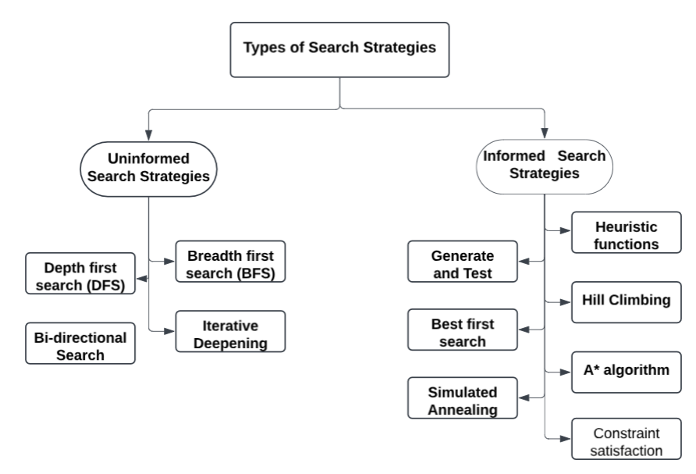
Types of Search Strategies:

Slide 8
Uninformed Search: Exploring Blindly
Characteristics
No domain knowledge used.
Simple but can be inefficient.
Guaranteed to find a solution in some cases.
Examples
Breadth First Search (BFS)
Depth First Search (DFS)
Uniform Cost Search

Slide 9
Best-First Search
Definition
Selects the most promising node based on an evaluation function, f(n) = h(n), where h(n) is the heuristic estimate to the goal.
Working
Uses a Priority Queue.
Expands the node with the lowest heuristic value first.
Example: If h(A)=10, h(B)=4, h(C)=6, then node B would be expanded first due to its lower heuristic value.

Slide 10
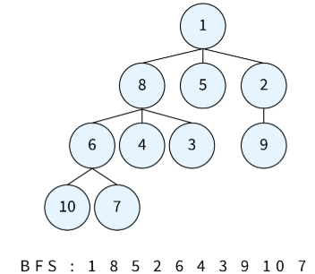
Algorithm of Breadth-First Search (BFS)
Create an empty queue, enqueue root.
While queue isn’t empty, continue process.
Dequeue the front node from queue.
Check if dequeued node is goal.
If not, enqueue unvisited neighbors.
Repeat until goal found or queue empty.

Slide 11




Breadth First Search (BFS)
Definition
Explores the state space level by level, expanding the shallowest node first.
Working
Uses a Queue (FIFO).
Explores all nodes at depth 'd' before 'd+1'.
Start A
Level 1: B C
Level 2: D E
Properties
Complete: ✔
Optimal: ✔ (if all costs are equal)
Space Complexity: High
Example: Graph A → B → D | C → E. Start: A, Goal: D. Traversal Order: A → B → C → D.

Slide 12
Advantages of BFS:
Finds the shortest path fast
Explores all possibilities
Simple and easy to implement
Guarantees complete solution
Good for shallow searches
Suitable for unweighted graphs

Slide 13
Disadvantages of BFS:
High memory consumption
Slow for large graphs
Inefficient for weighted graphs
Requires additional storage space
Fails with infinite paths
Expensive computationally at scale

Slide 14
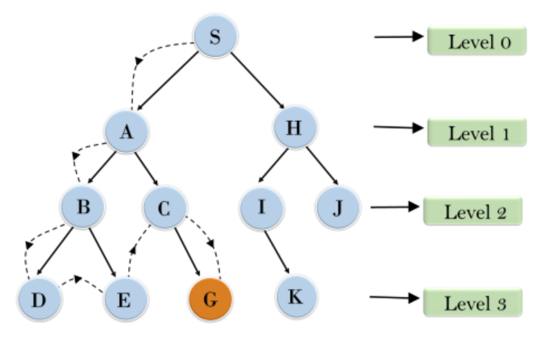
Depth-First Search (DFS)
Explores deeply before backtracking.
Uses a stack for tracking.
Time complexity: O(V+E)
Space complexity: O(V)
Not guaranteed to find optimal path.
May get stuck in infinite loops.

Slide 15
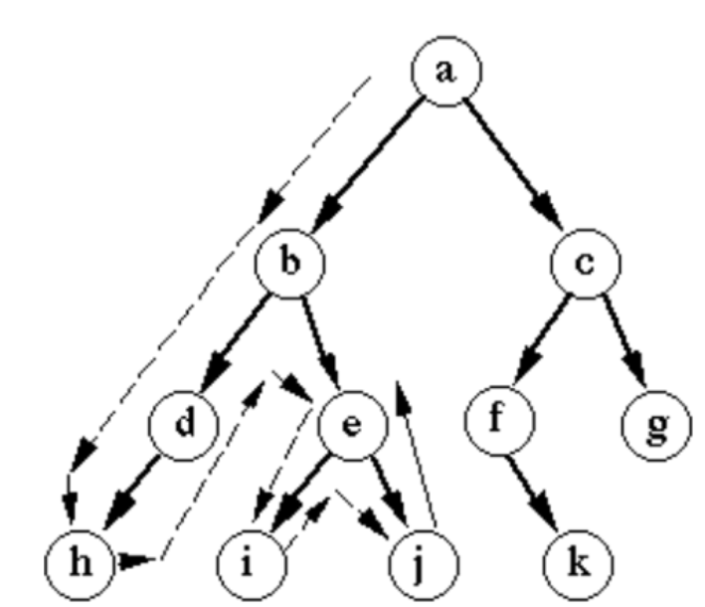
Algorithm of Depth-First Search (DFS)
Create an empty stack, push root.
While stack isn’t empty, continue process.
Pop the top node from stack.
Check if popped node is goal.
If not, push unvisited neighbors.
Repeat until goal found or stack empty.

Slide 16
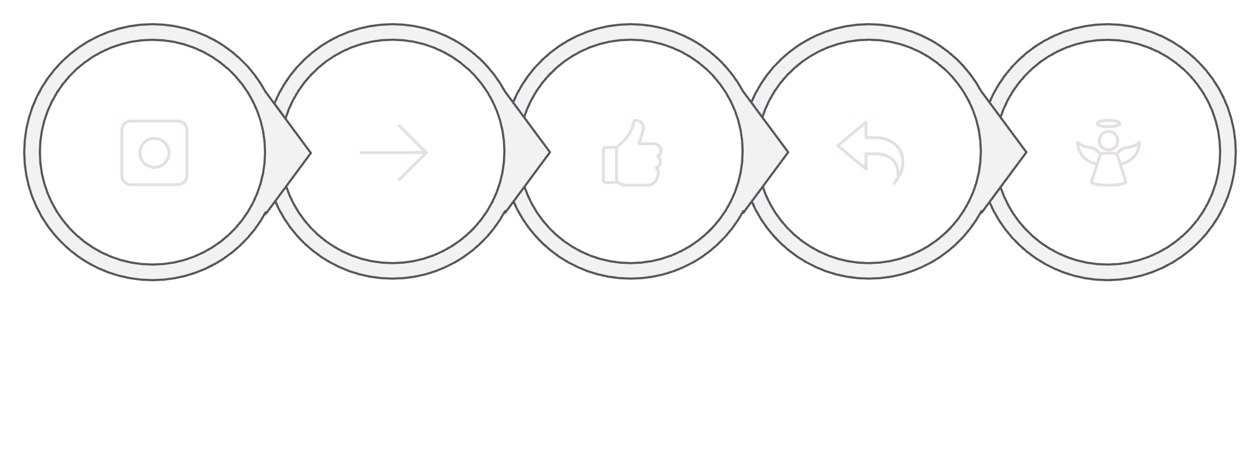





Depth First Search (DFS)
Definition
Explores as deep as possible along one branch before backtracking.
Working
Uses a Stack (LIFO).
Goes deep into a single branch.
A
B
D
C
E
Properties
Complete: ✖ (may get stuck)
Optimal: ✖
Memory Efficient
Example: Traversal Order: A → B → D → (backtrack) → C → E.

Slide 17
Advantages of DFS:
Low memory usage
Works well with deep graphs
Simple and easy to implement
Efficient for cyclic graphs
Suitable for pathfinding in mazes
Less storage space required

Slide 18
Disadvantages of DFS:
May not find shortest path
Not guaranteed to find all solutions
High time consumption in deep paths
Fails in graphs with loops
Can get stuck in infinite paths

Slide 19
Advantages of Uninformed Search Strategies:
Simple and easy to implement.
Requires no prior domain knowledge.
Guarantees finding a solution, if exists.
Suitable for small search spaces.
Systematic exploration of all possibilities.
Can be applied to diverse problems.

Slide 20
Disadvantages of Uninformed Search Strategies:
Inefficient for large search spaces.
High time and memory requirements.
Lacks optimization for best solutions.
Explores irrelevant or redundant paths.
Cannot handle infinite search spaces.
Fails in complex or dynamic problems.

